Slide 1
Crafting & Compelling Website Analysis, Audit and Recommendations

Slide 2
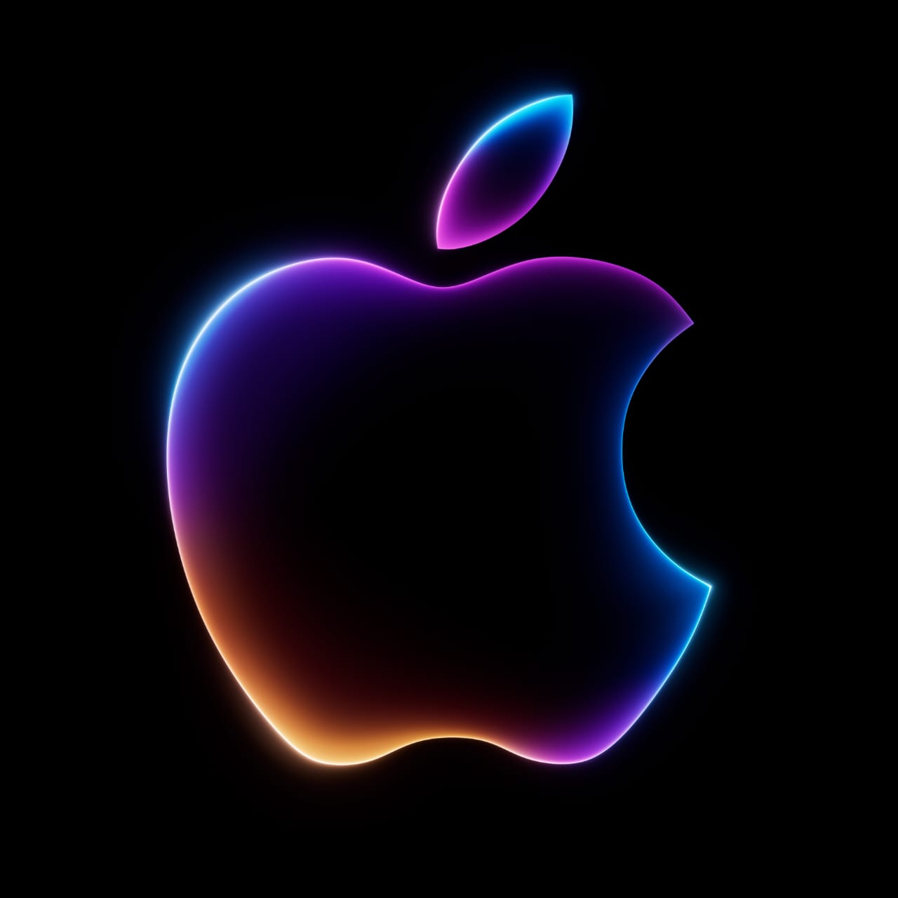

Slide 3
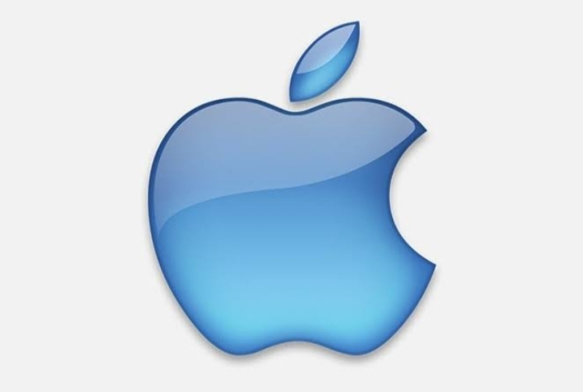
1.ABOUT OF APPLE
Apple is one of the most influential and successful companies in the world. The brand is known for its innovative and high-quality products, such as the iPhone, the Macbook, and the iPad. But Apple is also famous for its iconic logo design, which features a stylized apple with a bite taken out of it. The logo is simple, elegant, and memorable, and it reflects the company's values and vision.

Slide 4
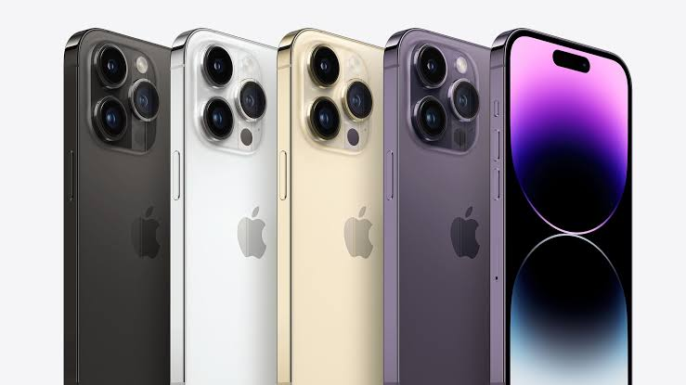
2. Product and Service Descriptions
ProductS
iPhone: Apple's flagship smartphone, the iPhone, has redefined the mobile exprience. With its powerful processors, stunning displays, and advanced camera systems, the iPhone offers a seamless integration of hardware and software.
1

Slide 5
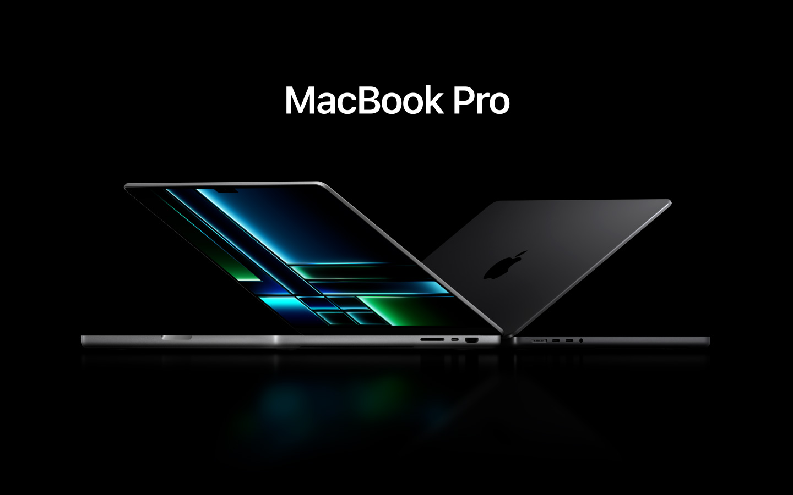
Mac:
Apple's line of personal computers, the Mac, is renowned for its elegant design, powerful performance, and user-friendly macOS operating system. Macs are popular among professionals and consumers alike, offering a premium computing experience.
2

Slide 6
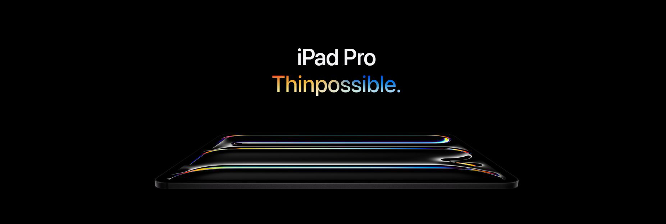
iPad:
The iPad is a versatile tablet that bridges the gap between smartphones and laptops. With its large, high-resolution display, powerful processors, and intuitive iPadOS, the iPad is ideal for productivity, entertainment, and creative tasks.
3

Slide 7
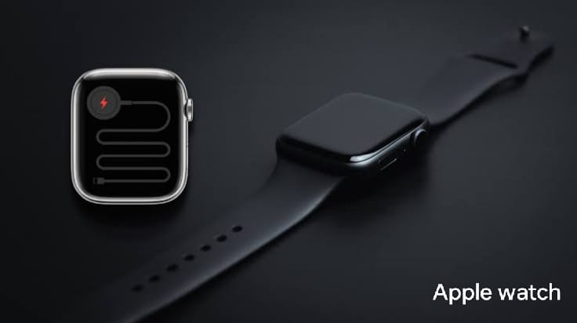
Apple Watch:
Apple's smartwatch, the Apple Watch, is a wearable device that offers a range of features, including fitness tracking, health monitoring, notifications, and app integration. With its stylish design and advanced capabilities, the Apple Watch has become a popular choice for health-conscious individuals.
4

Slide 8
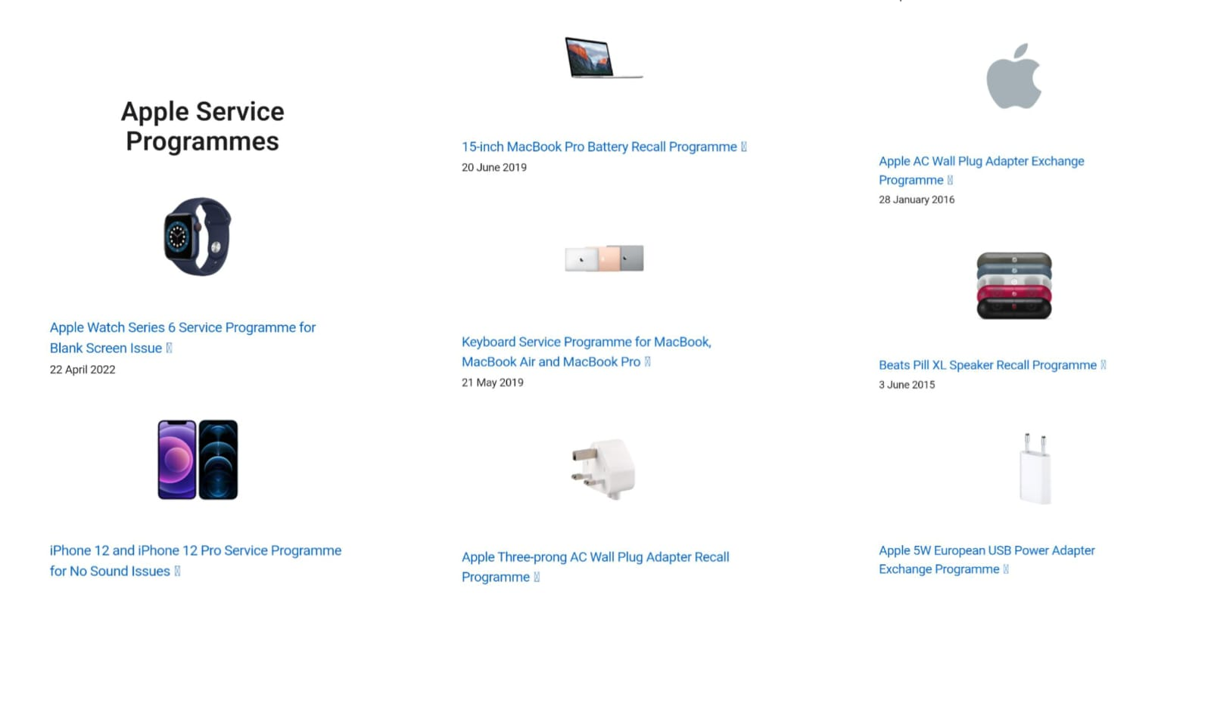
Services:
Apple also offers a suite of services, including Apple Music, Apple TV+, Apple Arcade, iCloud, and Apple Pay. These services provide users with access to a vast library of music, movies, games, cloud storage, and secure payment solutions.

Slide 9
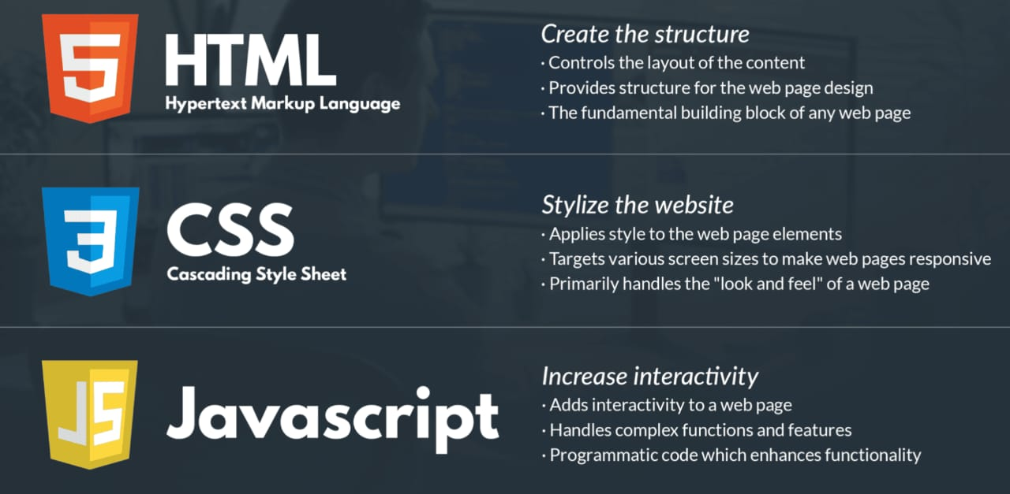
3.Website Platform Identification
The Apple website was developed using a combination of technologies, including HTML, CSS, and JavaScript. Apple is known for its attention to design and user experience, so the website likely utilized advanced web development techniques and frameworks popular at the time of its creation.

Slide 10
4.Responsive Design Testing
HOMEPAGETESTING:https://www.apple.com/
ACCESSORIESTESTING:http://www.apple.com/shop/accessories/all
STORE TESTING:http://www.apple.com/store
Entertainment Testing:https://www.apple.com/services/
VISION TESTING:http://www.apple.com/apple-vision-pro/
v

Slide 11
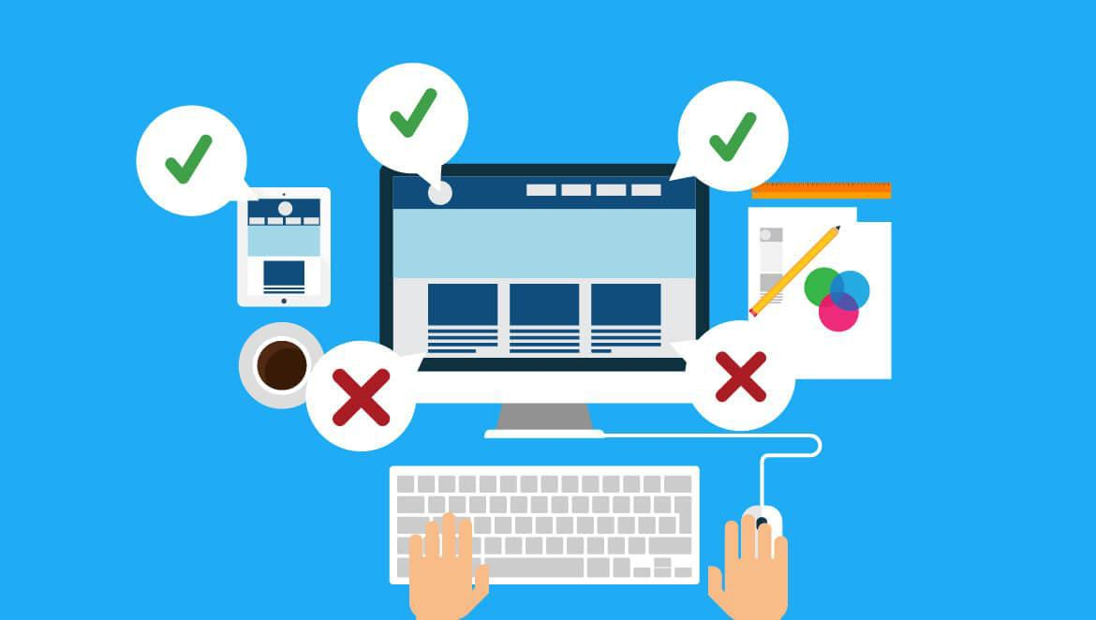
5.Website Mistakes Identification
Cluttered Layouts
Slow Loading Times
Poor Mobile Optimization
Inconsistent Branding
Complex Navigation
*
*
*
*
*

Slide 12

6.Best Practices List
.Embrace Apple's Design Language
.Prioritize User Experience
.Focus on Clarity and Simplicity
.Pay Attention to Detail
.Follow Apple's Human Interface Guidelines
.Test and Iterate

Slide 13
7.WEBSITE LINK
Click here

Slide 14
THANK YOU

